Slide 1
BREAST CANCER DETECTION USING RANDOM FOREST

Slide 2
Group Member Information
Name : Leela Sekhar Chowdary Mannava
Student id: 700740979
Name : Sravya Mannava
Student id: 700747750
Name : Phani Datta Pabisetty
Student id: 700741652
Name : Venkata Naga Nikhil Reddy sanikommu
Student id: 700746372

Slide 3
ROLES AND RESPONSEBILITY
ROLES | RESPONSEBILITY
Project planning Requirement analysis Data collection and cleaning | LeelaSekhar Sravya Venkata Naga Nikhil
Exploratory data analysis Choosing model Performance evaluation Performance evaluation | Leela Shekar PhaniDatta Phani Datta
Documenting the project Summarizing the results Python code | Venkata Naga Nikhil sravya Leela Sekhar
Video recording of the project Uploading the project into Github Documenting final report | Leela Sekhar + Venkata Naga Nikhil Phani Datta Sravya

Slide 4
Motivation
Breast cancer is the most prevalent health problem. The main drawbacks are breast cancer screening methods and non-invasive, hazardous radiation.
A quick and efficient diagnosis can improve the chance that patients will receive treatment, decreasing the mortality rate from breast cancer.
One of the Machine learning techniques that is frequently used in disease diagnosis is random forest. The samples and characteristics included in the decision trees are two key areas where the random of it is evident.

Slide 5
OBJECTIVES
Collect the data and Analyse it from the repository and identify the missing values and clean the data.
Training and Testing datasets for the model.
It used to predict breast cancer using ensemble models like boosting, voting, and bagging techniques.
The random forest algorithms are used and implemented in the Python interface.
The results of implementing random forest to identify breast cancer will be accurate.

Slide 6
Related work
Traditionally, breast cancer is detected using a mammogram x-ray, which is very costly, and sometimes, this test will not show accurate results.
Breast cancer can be identified and predicted using X-ray imaging. However, it might be difficult to conclude when combining imaging and clinical data.
The patient's disease cannot be identified in the early stages by following the medical report. So we use some machine learning techniques to overcome this problem.
Ensemble model To improve the accuracy of predictive analytics, ensemble modeling combines the outputs of two or more related but distinct analytical models into a single score or spread

Slide 7
Bagging is an ensemble approach that combines the predictions from all models after fitting them to various subsets of a training dataset.
Boosting method reduces errors in predictive data analysis of the tanning data sets.
A voting classifier helps machine learning evaluate that it generates multiple basic models or estimators.
Random forest is one of the supervised machine learning models. A randomly selected data set is initially chosen by the random forest classifier, producing many decision trees.
Python package will compare different types of datasets and helps to predict accurate results.

Slide 8
Problem Statement
The Symptom of this cancer occurs when a few breast cells begin to develop abnormally, and lumps are formed in breast tissue. However, these cannot be predicted through datasets.
To find out whether the person has Breast Cancer, the person must undergo through mammogram x-ray test, which is expensive.
Generally, the Medical datasets are improper and not accurate.

Slide 9
Proposed Solution
Machine learning methods in the medical industry made a huge impact to reduce human effort and at the same time with accurate results.Predicting the diseases from the clinical parameters is easy but the size of the data is dependent on the number of volunteers. However we can use ensemble methods to make the predictions efficient even the size of the data is low.
The data preprocessing help to identify the missing values in the datasets and helps to handle the missing values
The Exploratory data analysis will analysis the data from the repository and get the structure of data and make some observations are drawn from the visualizations.
The cleaned data will be send to Ensemble models. In this phase the best stage model will be selected from the given three model i.e, bagging, boosting and voting classifiers based to the datasets.
In the next phase the python interface help to get the choose model and help to get the result.

Slide 10
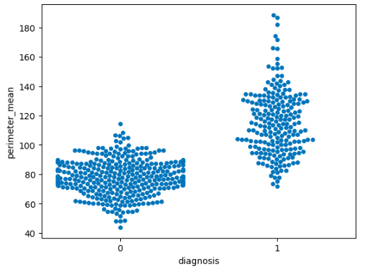
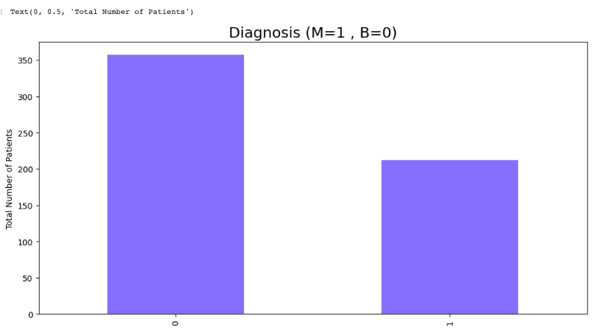
Comparison/Analysis
Shows the categorical values representing the values of both Malignant and Benign values.
Comparing two types of breast cancer and its stages

Slide 11
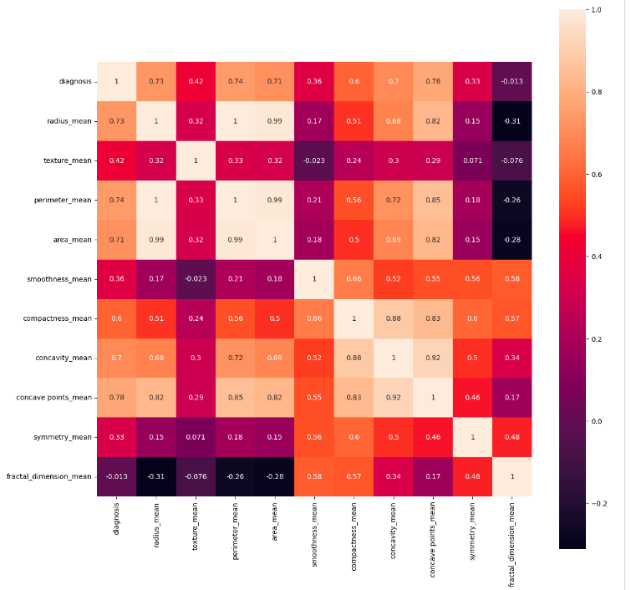
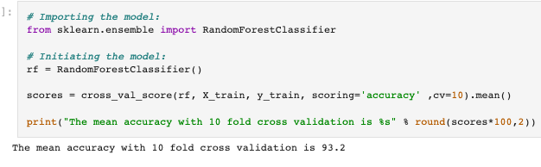
The diagnosis and the means for radius, perimeter, area, compactness, concavity, and concave points are highly related using heap map
Result:

Slide 12
References
https://www.javatpoint.com/machine-learning-random-forest-algorithm
https:www.researchgate.netpublication351893325_Early_Diagnosis_of_Breast_Cancer_Prediction_using_Random_Forest_Classifier
https://www.cancerresearchuk.org/about-cancer/breast-cancer/symptom
https://echtarget.com/searchdatamanagement/definition/data-preprocessing#:~:text=Data%20preprocessing%20transforms%20the%20data,pipeline%20to%20ensure%20accurate%20results
https://www.javatpoint.com/python-os-module#:~:text=Python%20OS%20module%20provides%20the,under%20Python's%20standard%20utility%20modules

Slide 13
Thank you !

